Slide 1
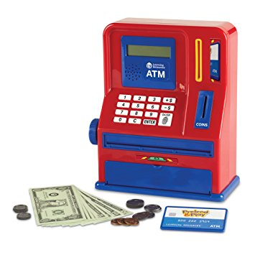
ATM Project
Mary Husain | Michal Porubcin | Andrew Quijano | Bryce Yoo

Slide 2
Overview
Core Functionality
User Interface
Encryption
Database
Online ATM
User Accounts
Tools & Services
Installation
The UI is kept intuitive and user-friendly, with basic functions including sign up, login, view balance, deposit and withdraw
Login
Creates session for bank transaction
User can create new account
View Balance
View current amount of money
Deposit/Withdraw
Supports modifying balance and checks if user can withdraw without overdrawing.
The ATM project has built in security features.
AES (Encryption)
Secure and fast symmetric key to encrypt traffic between server and client.
Blowfish (Hashing)
Hide PIN from system admins
Add a layer of authentication when user submits PIN
Future Upgrade
Server Authentication
Client Authentication
This project uses the Heroku Postgre-SQL database
Ease of Usage
Doesn’t require as much effort to set up as building a new MySQL server
Ease of Credentials
Doesn’t require as much effort to set up as building a new MySQL server
github repository: https://github.com/mari-husain/csharp-atm

Slide 3
Overview
Core Functionality
User Interface
Database
Encryption
Subhead | Subhead | Subhead | Subhead
Users/Services User features ATM Services | Login/Sign up Signup Screen Login Screen | Database Heroku Why it is used How it is used | Supported Security Features AES SHA-256
Code Documentation/Workflow Work Flow Diagram Code Design | Main Interface Login Screen Signup Screen | Database Implementation Tables used Examples | Hash Function Encryption Blowfish Why it is used Examples
Installation Required Packages | Modify Account Deposit Withdraw | Database View At runtime | Future Development ATM Server Authentication Client Authentication

Slide 4
Core Functionality
User Accounts
First Name
Last Name
PIN Code
Account Balance
Services
Withdrawals
Multiples of $20
Quick withdrawal options from $20 - $100
Manual for amounts larger than $100
Deposits
Any positive amount (minimum $0.01)

Slide 5
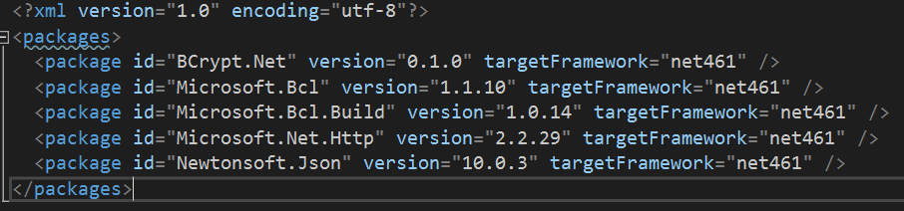
Installation
To install: Create new Project, and select ASP.NET Web Application
Select ASP.NET 4.6.1 Templates, Web Form.
After copying/adding files to solutions, install the following packages (seen in packages.config) using Nuget.

Slide 6
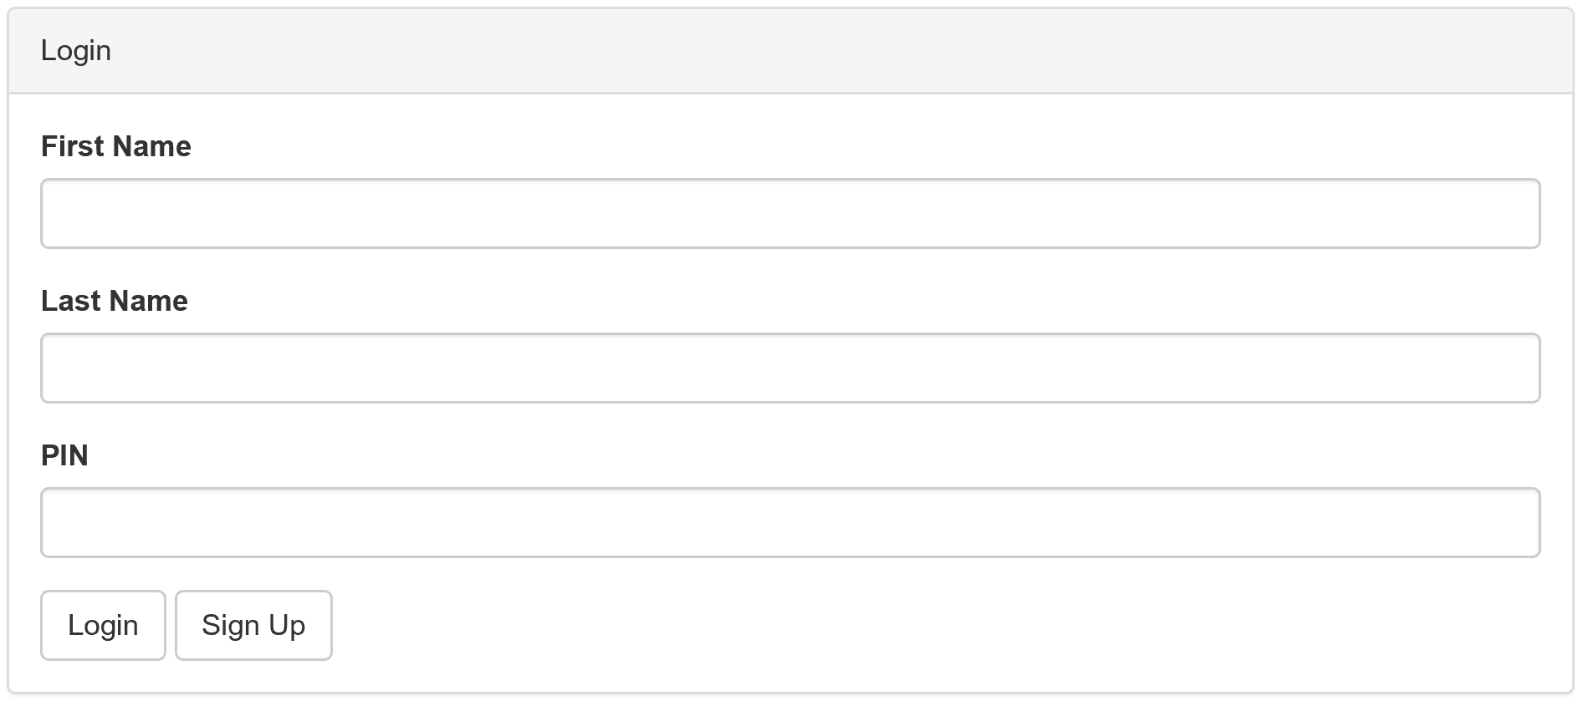
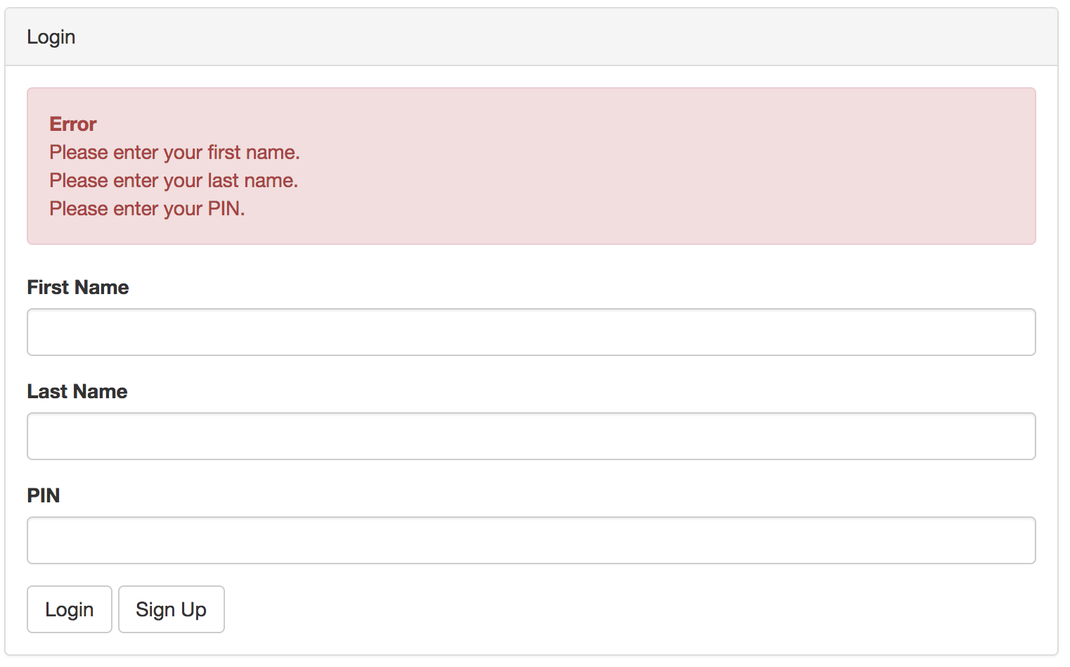
Login Screen and Validation
Requirements
Enter first name, last name, PIN
Validation
Entries cannot be blank/null (Exhibit 2)
Entries must match existing account (Exhibit 3)
Login information must be correct (Exhibit 4)
Exhibit 1
Exhibit 2

Slide 7
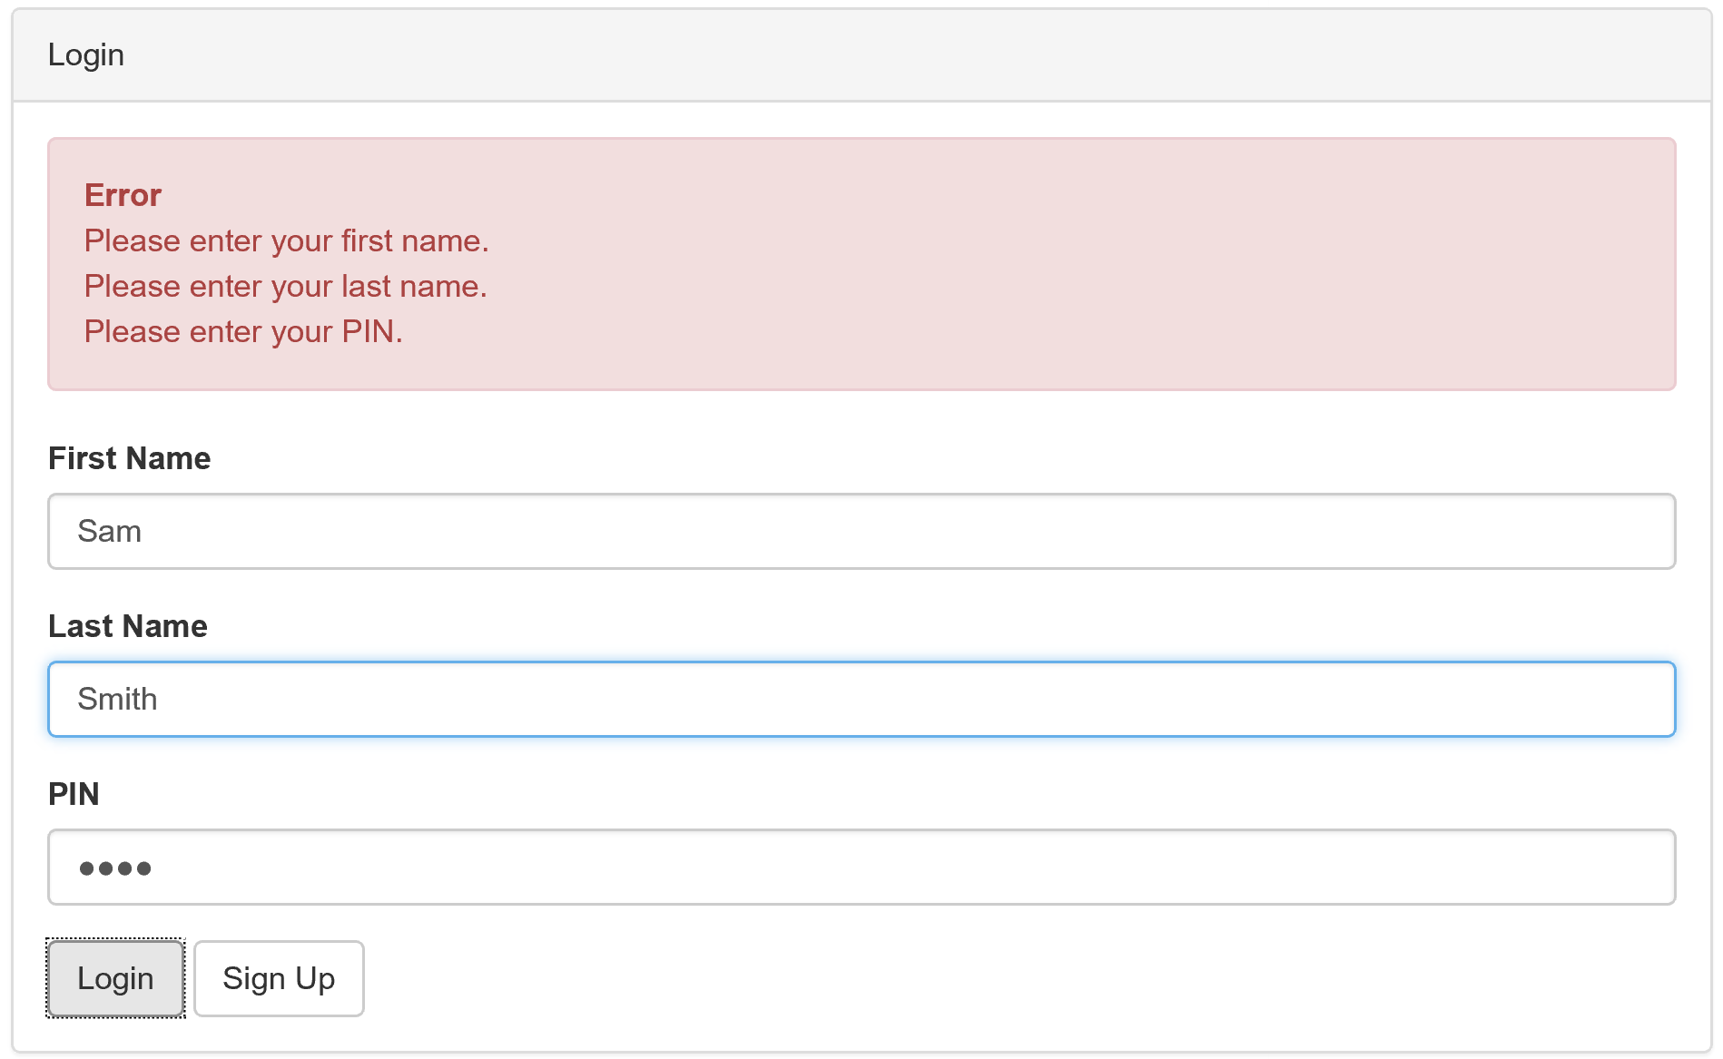
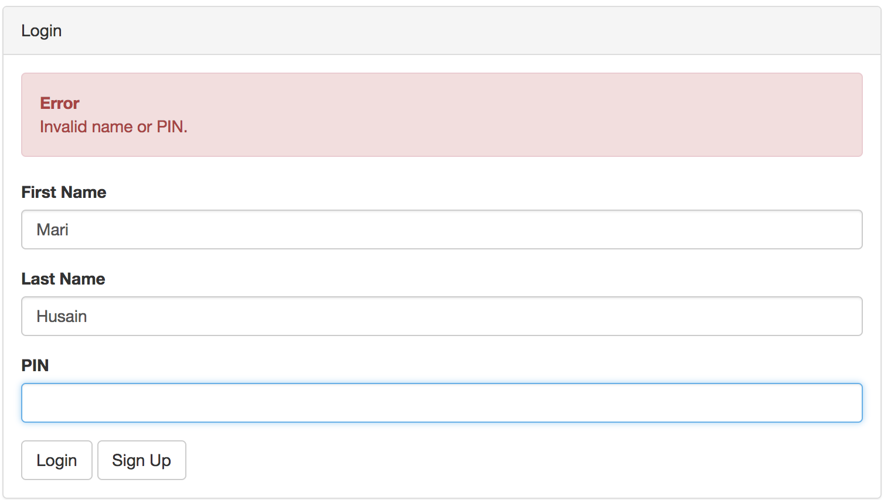
Login Screen Validation
Entries must match an existing account
Login information must be correct
Exhibit 4
Exhibit 3
Notes:
Entries must match existing account (Exhibit 3)
Login information must be correct (Exhibit 4)

Slide 8
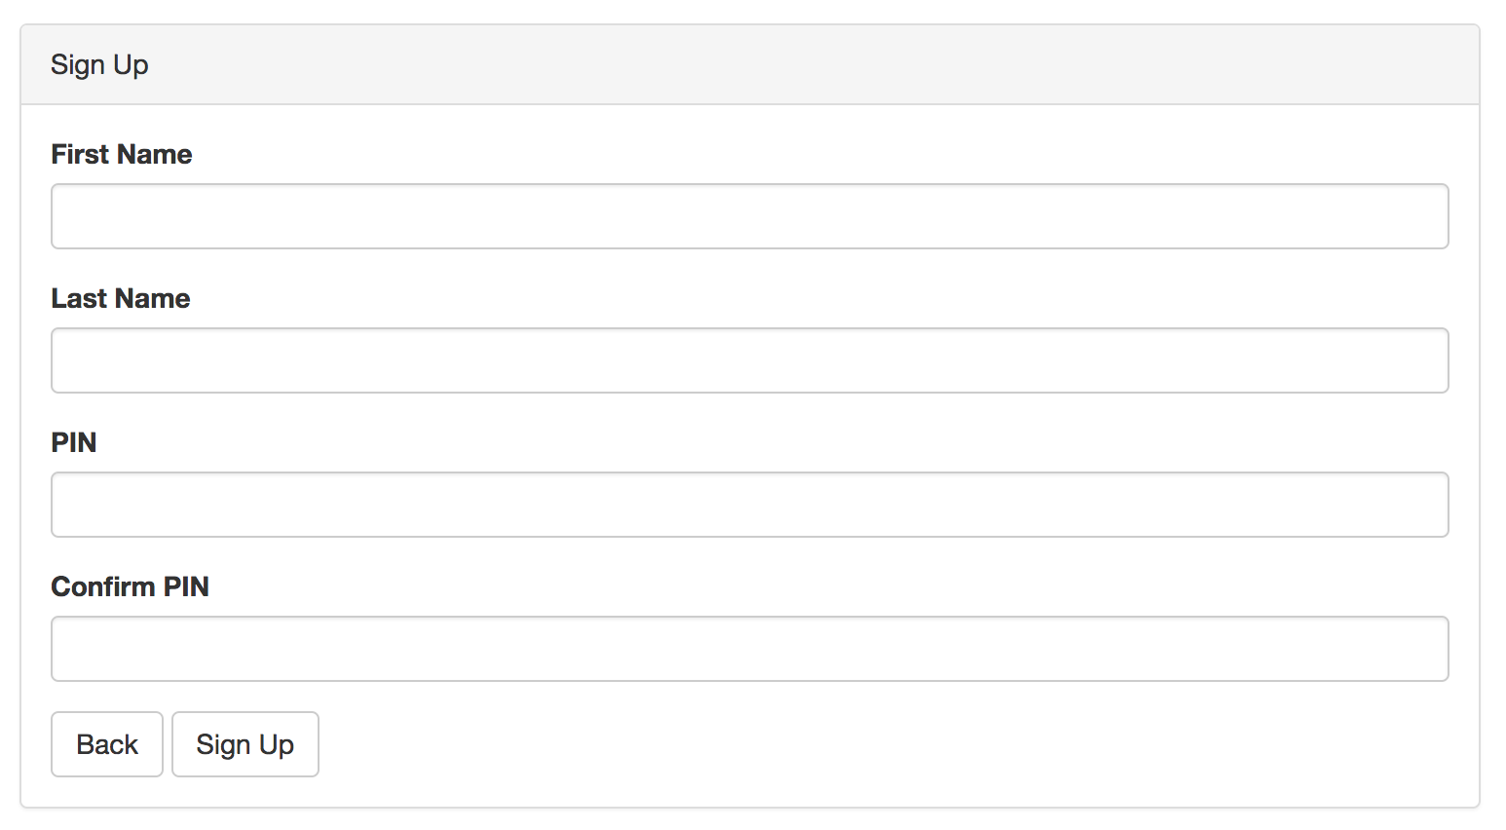
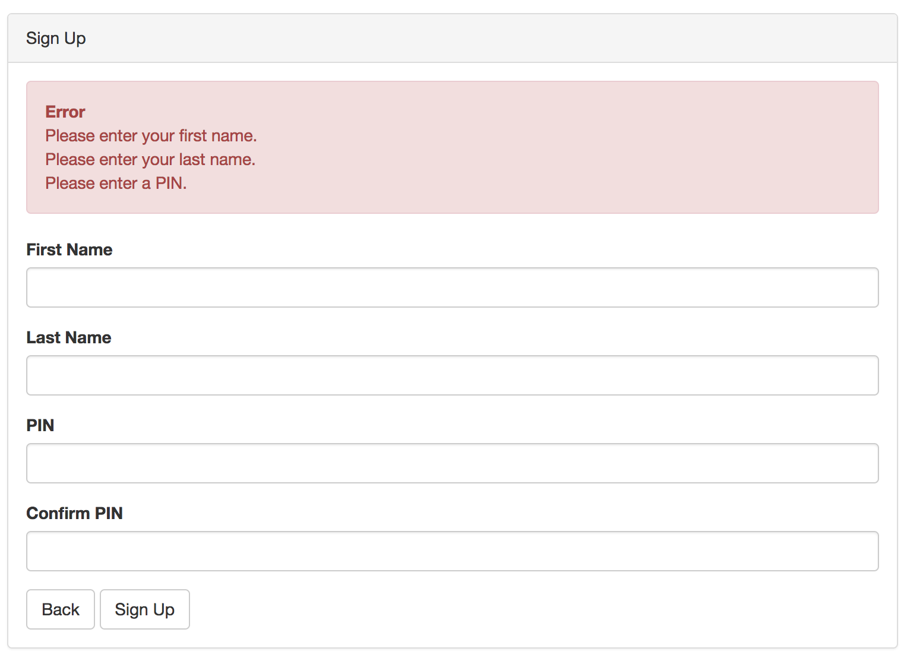
Sign up Screen and Validation
Requirements
Enter first name, last name, PIN, confirm (Exhibit 5)
Validation
Entries cannot be blank/null (Exhibit 6)
PIN must be numbers (Exhibit 7)
No limit on PIN length
PIN must match confirm PIN (Exhibit 8)
Only one combination of first/last name can exist → 1 account per user! (Exhibit 9)
Exhibit 5
Exhibit 6
Notes:
To sign up, users need to input their first name, last name and confirm their PIN.
No null values will be accepted (e. g. Mari must have a PIN)
The PIN/Confirm PIN must match
The PIN must consist of numbers, can be any size

Slide 9
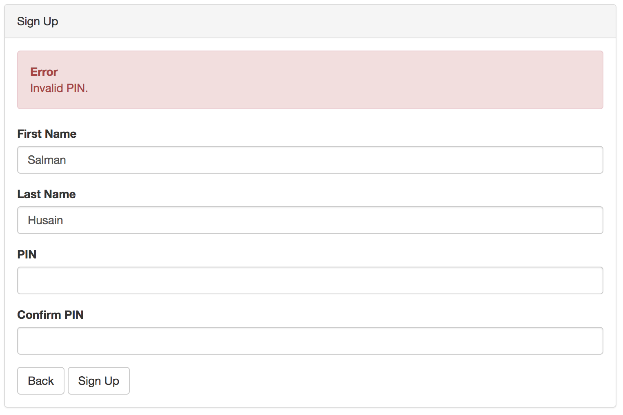
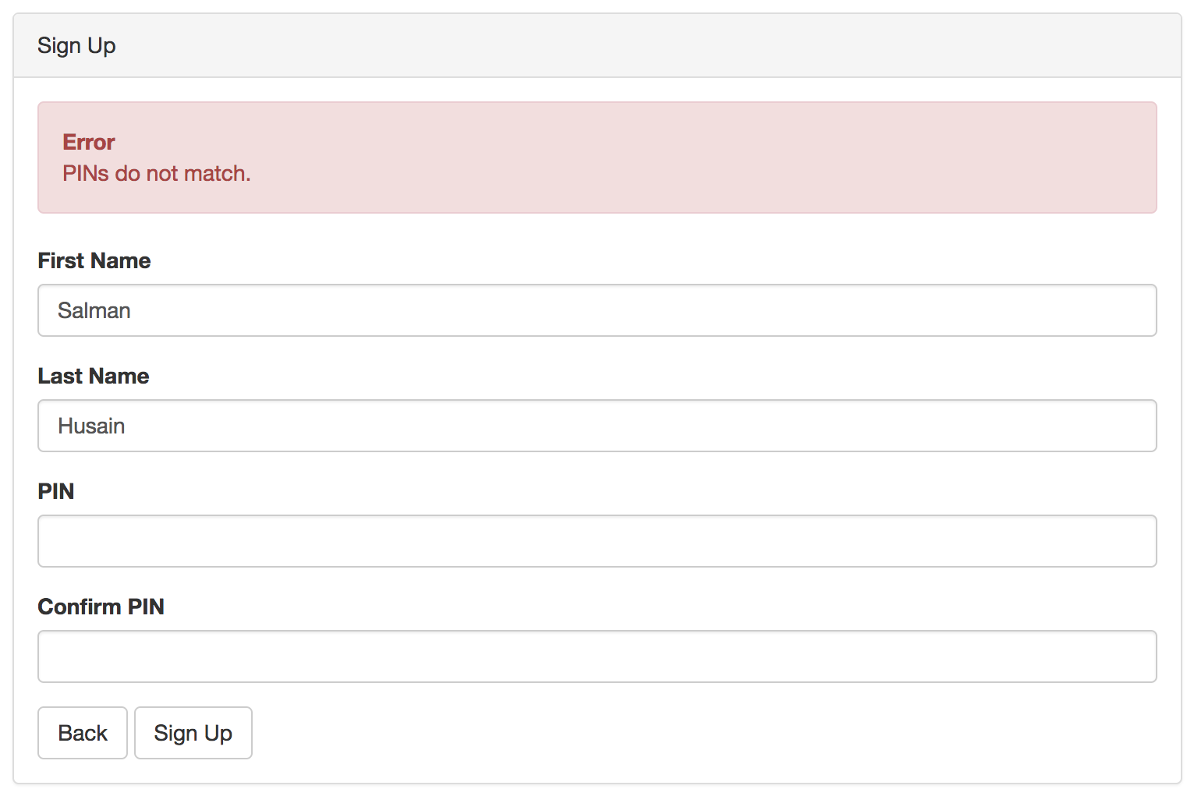
Sign up Screen Validation
PIN must consist of numbers
PIN must match Confirm PIN
Exhibit 7
Exhibit 8
Notes:
Entries must match existing account (Exhibit 3)
Login information must be correct (Exhibit 4)

Slide 10
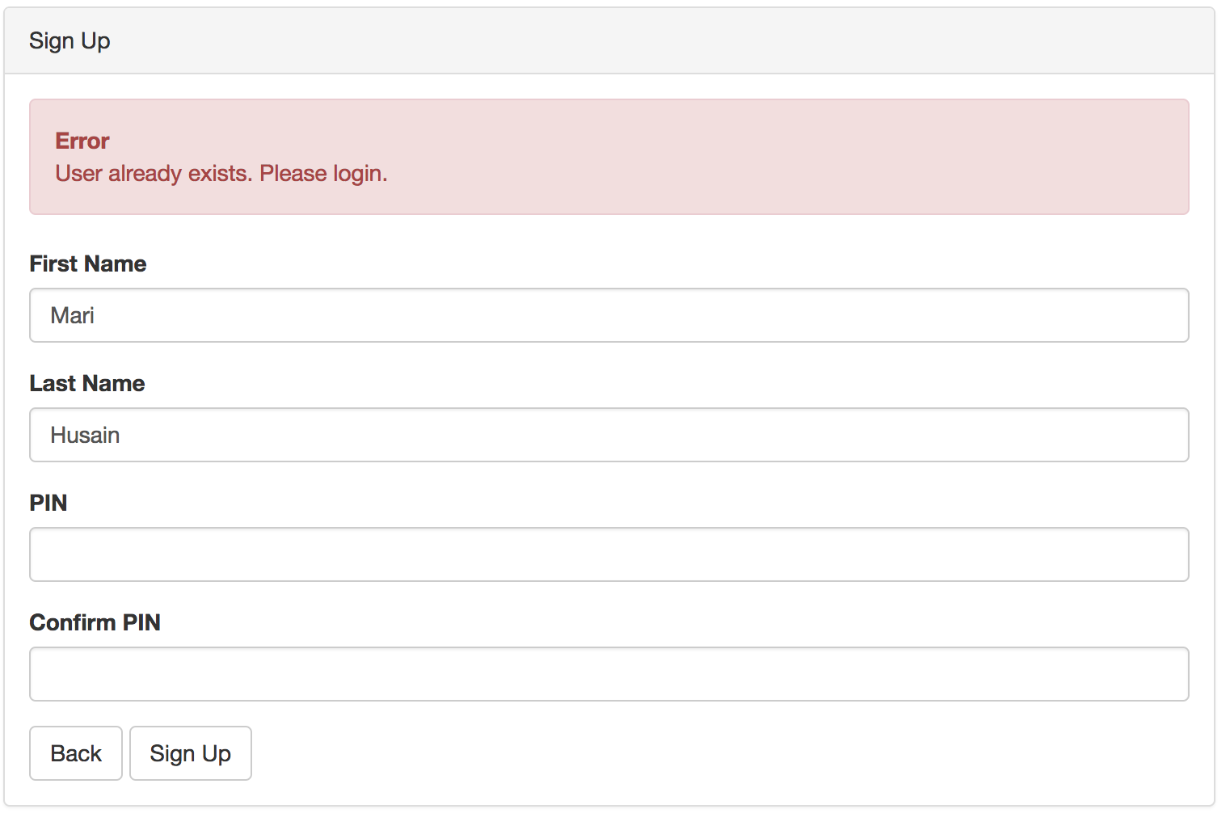
Sign up Screen Validation
First and Last name combination cannot already be in use
Exhibit 9
Notes:
Entries must match existing account (Exhibit 3)
Login information must be correct (Exhibit 4)

Slide 11
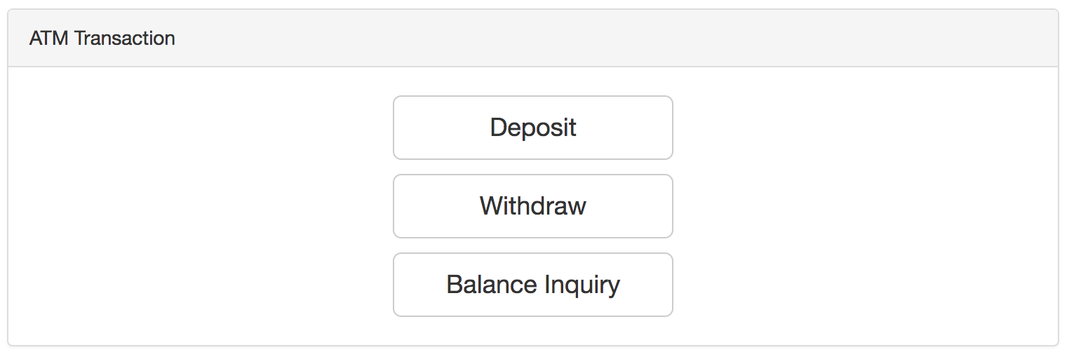
UI - Main Interface
ATM keeps track of what bills are inside of it on the server. Displayed in header once user is authenticated.
Money is emptied out and restocked at 12:00 AM each day, loaded with 500 $20 bills
User may conveniently logout by clicking this button in the header
To view your account balance, click “Balance Inquiry”

Slide 12
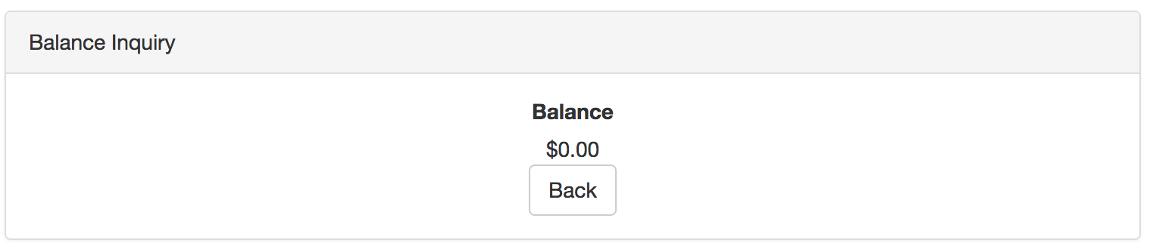
UI - Balance Inquiry
To return to the main interface, click “Back”

Slide 13
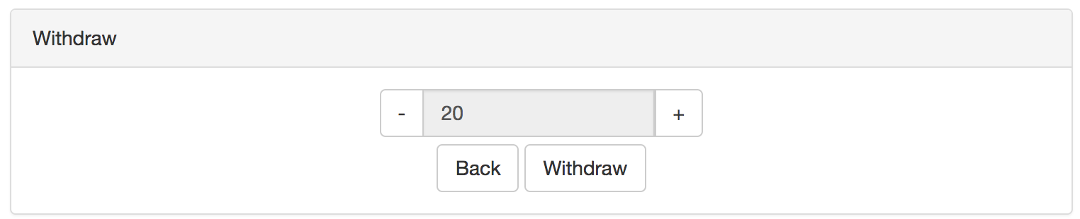
UI - Withdraw
Must specify a multiple of $20.
+/- buttons implemented to enforce this requirement.
To return to the main interface, click “Back”
To Withdraw specified amount, click “Withdraw”

Slide 14
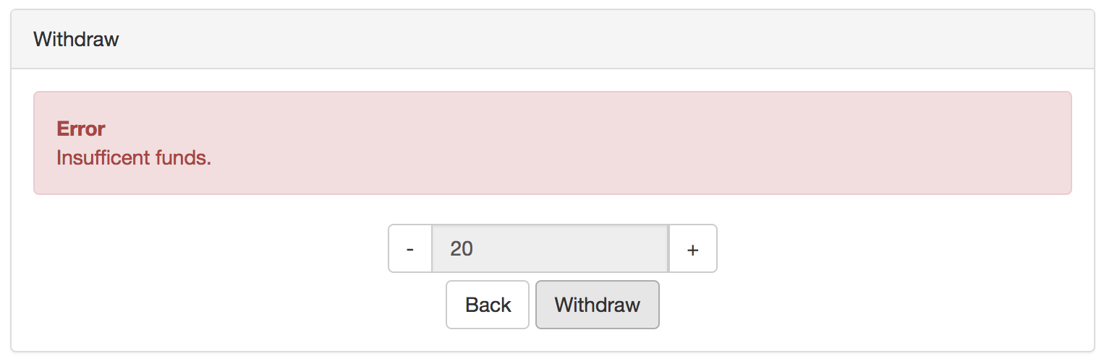
UI – Withdraw Validation
A user cannot withdraw more money than there is in the account. Negative balances are not accepted.

Slide 15
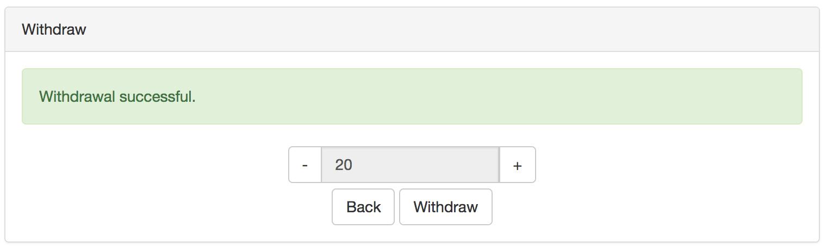
UI – Withdraw Validation
Successful withdrawal has taken place

Slide 16
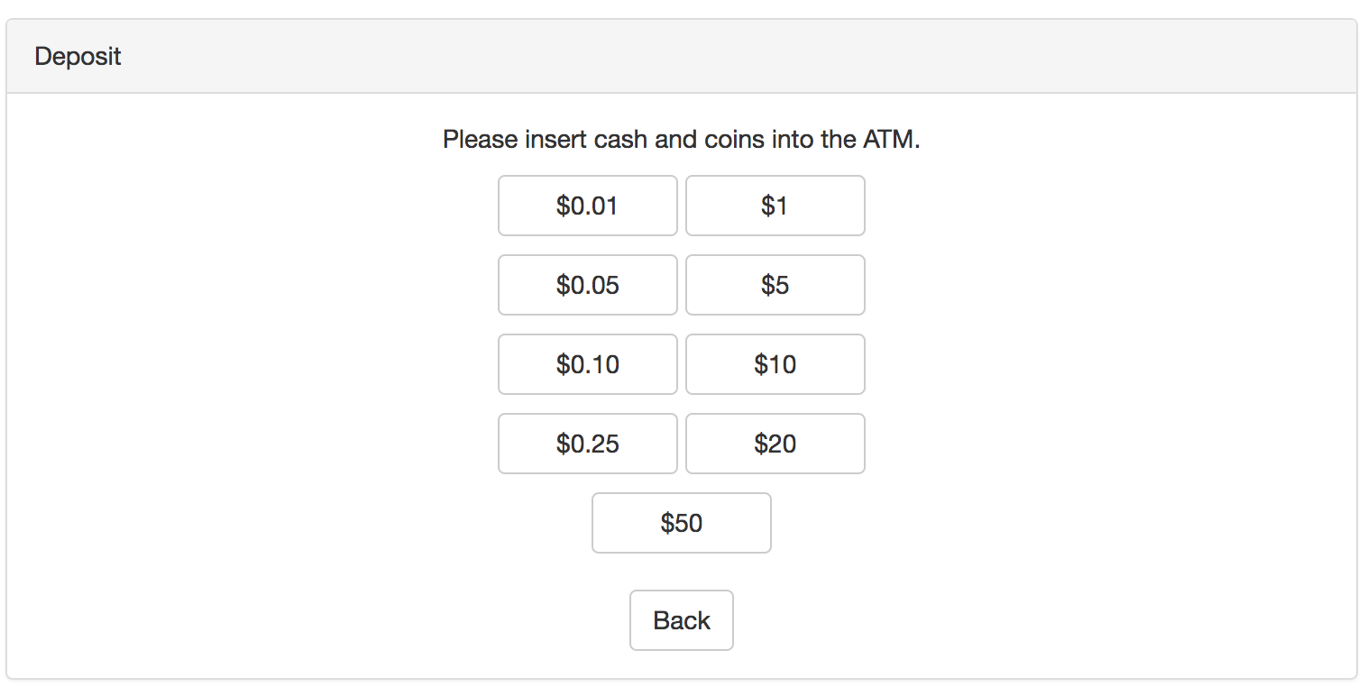
UI – Deposit
Only select bills and coins are accepted by the ATM
The bills stored in the ATM will update upon refreshing the page

Slide 17
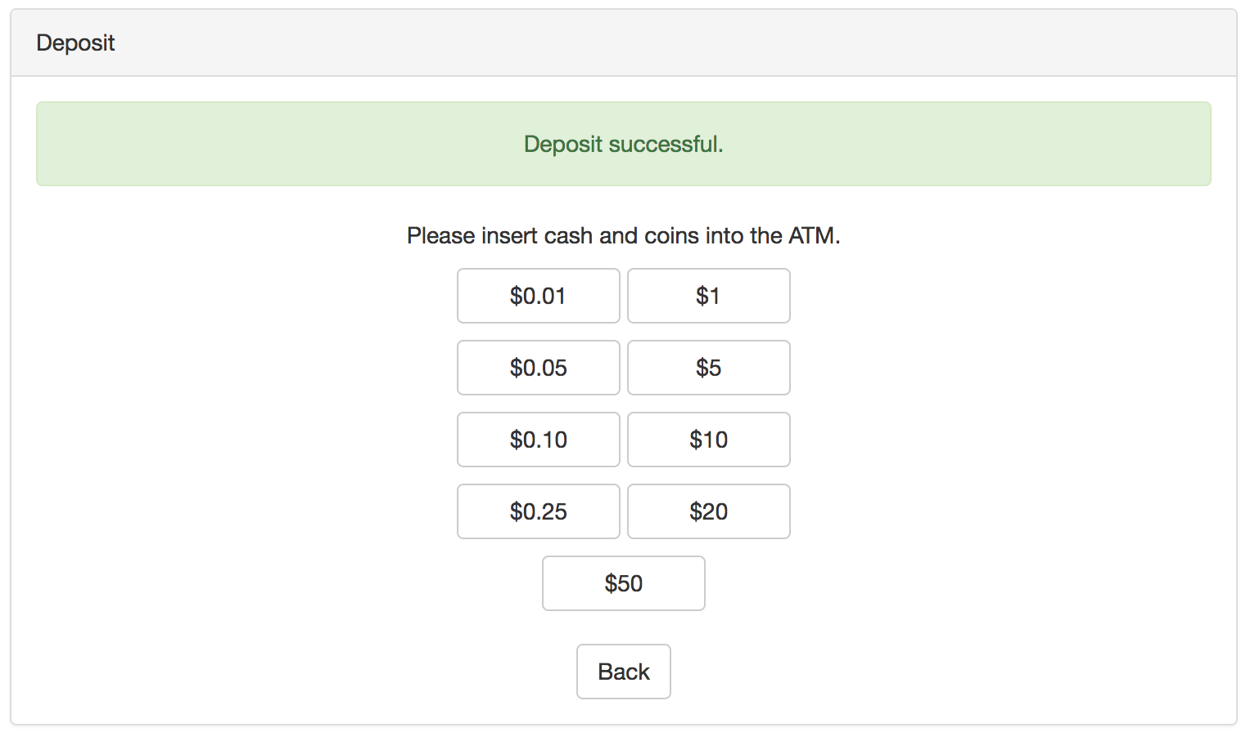
UI – Deposit
Notice that the number of $50 bills has changed following the deposit session

Slide 18
Database
Heroku
Cloud Application Platform based on a managed container system
Platform as a service (PaaS)
Integrated data services and powerful ecosystem
App-centric approach for software delivery
Allows us to build, run and operate our app entirely in the cloud
Basic services available free of charge

Slide 19
Database Implementation
See Other/atm_backend/atm_serv.py
Heroku allows for easy set up of the database and uses the same commands as SQL.
The web server would call the predefined SQL queries (using insert, select and update)
Example 1: name_exists is a select query to check if a user already exists on the database
Example 2: create_account uses insert to create the new account on signup screen
Example 3: update uses an update command to update the value of the account Balance

Slide 20
Exploring Encryption Alternatives
Systematic-Key Encryption (e.g. AES)
Hash Function (e.g. SHA, blowfish)
Symmetric Key, permits for encryption and decryption of plaintext
Performance Strength: An AES-128 bit key is faster than public key algorithms like RSA.
Security Strength: An AES is more resistant to quantum computers than RSA.
AES-128 is equivalent to 3072 bit RSA key. An AES-256 key is equal to a 15360 RSA bit key.
Security Weakness: Should the Secret Key be stolen if the Database is hacked, the security benefit of AES is nullified
Security Weakness: AES secret key needs to pre-installed on the client and server. This can be resolved through using the Diffie-Hellman Key Exchange.
Hashing is a one way function that is used for authentication.
Security Strength: A system admin can’t see a PIN in plaintext
Blowfish is roughly equivalent to SHA-256 in strength
Security Strength: robust and resistant brute force attacks
It is difficult to use an array of graphics cards to attempt to find the correct input of a Blowfish Hash
SHA-256 strength/weakness is it can be implemented on GPUs, giving attackers a computational boost
Implementation: simple with Bcrypt
Easy blowflish package for C#
Obtained with Nuget
Add salt to protect against Rainow Tables (pre-computed hashes)

Slide 21
Hash Function Encryption
Deterministic
Pre-image
resistance
Adaptive
function
Secure Online
Teller Machine
Fast block
cipher
Collision
resistance
Small memory
footprint
Password
hashing
function
OpenBSD
Resistant to
rainbow
table attacks

Slide 22
Encryption and Security
Client
User enters PIN
Client hashes the PIN using Blowfish algorithm (with salt)
Client sends [Hashed PIN + salt] to server
Server
Signup: Server stores [Hashed PIN + salt] in database. The original copy is created when a user makes their account.
Login: Server verifies Hashed PIN against value in database

Slide 23
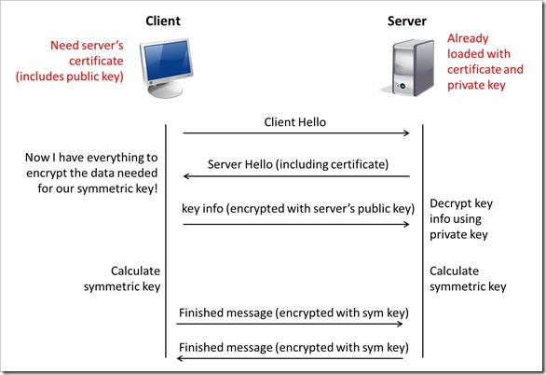
Future upgrades: TLS
We can use TLS and have signed certificates placed on client and server
Server encrypts hash with a Private key. Client decrypts with Public Key.
Since only the server has the private key, it assures the client it is communicating with the server.
Compute AES key using Diffie-Hellman

Slide 24
Work Distribution
Mary Husain (Leader)
Built the Backend Heroku Database for the ATM
- Set up network communication between front end and backend
Andrew Quijano
Completed PowerPoint slides on installation, security, etc.
Completed overall system design and code documentation
Bryce Yoo
Prepared project PowerPoint presentation
Designed and wrote front end of webpage
Michal Porubcin
Implemented AES and Hashing to the ATM service
Tested ATM program for bugs and validation

